Slide 2
NOW THE REAL WORK BEGINS!
HOW TO GET ORGANIZED FOR EFFECTIVE LEGISLATIVE ACTION

Slide 3
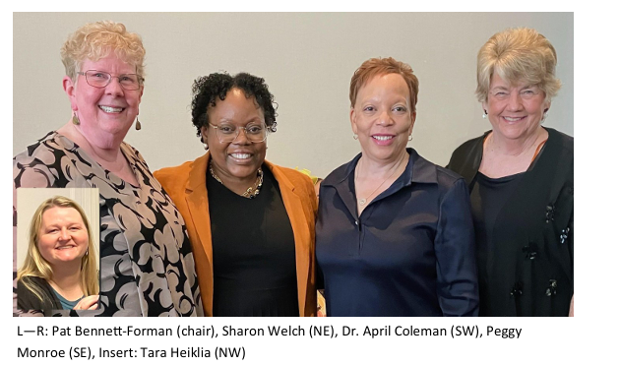
DKG U.S. FORUM STEERING COMMITTEE

Slide 4
DKG U.S. FORUM
We are positional, but we are not partisan.
We advocate and agitate, but we do not aggravate.
We organize, but we do not opine.
We are passionate, but we do not pontificate.
WE ARE WOMEN ADVOCATING FOR LEGISLATIVE ACTION!

Slide 5
WHY ARE WE HERE?
To understand the importance of tracking legislation.
To understand how to track legislation.
To be effective in influencing legislative action at the local, state, and national levels.
We are all personally and professionally impacted by legislative decisions. The best way to participate in democracy is to stay informed and to TAKE ACTION!

Slide 6
H.R. 82 THE SOCIAL SECURITY FAIRNESS ACT OF 2023 On January 5, 2025, the President signed into law H.R. 82, the Social Security Fairness Act of 2023. The law repeals the Windfall Elimination Provision (WEP) and Government Pension Offset (GPO) provision, both of which could reduce Social Security benefits when someone received a pension based on work that was not covered by Social Security. The law applies with respect to benefits payable for months after December 2023. (WEP and GPO continue to apply to benefits payable for months before January 2024.)

Slide 7
HOW BILLS BECOME LAWS
You CAN influence what happens at EVERY step!
DRAFTING
INTRODUCTION
COMMITTEES AND HEARINGS
FLOOR DEBATES AND VOTES
RECONCILIATION
EXECUTIVE APPROVAL OR VETO

Slide 8
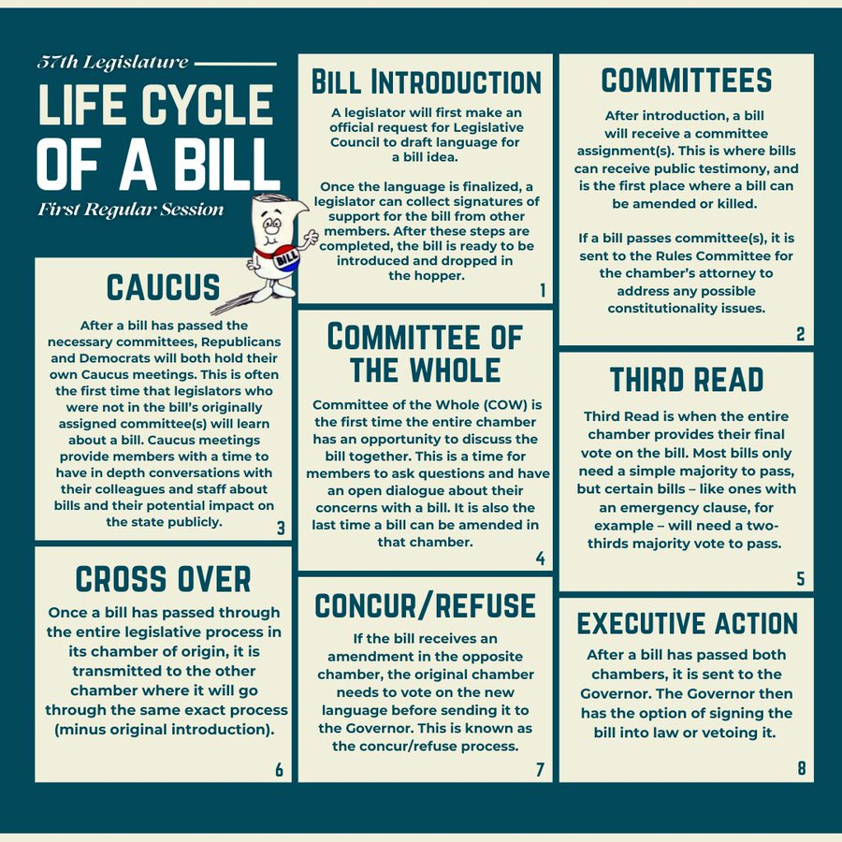
HOW BILLS BECOME LAWS IN ARIZONA

Slide 9
TOOLS AND RESOURCES FOR TRACKING LEGISLATION
OFFICIAL GOVERNMENT PLATFORMS
U.S. Senate U.S. Senate: Bills, Acts, & Laws
Office of The Clerk, US House of Representatives Office of the Clerk, U.S. House of Representatives - Votes
THIRD-PARTY PLATFORMS
GovTrack.us GovTrack.us: Tracking the U.S. Congress
LegiScan US Congress Legislature | 2025-2026 | 119th Congress | LegiScan
Fast Democracy Free bill tracking for US Congress - FastDemocracy
LOCAL NEWS AND ADVOCACY GROUPS

Slide 10
PRACTICAL STEPS TO TRACK LEGISLATION
IDENTIFY RELEVANT TOPICS-DEFINE FOCUS AREAS OR KEY WORDS
FIND THE BILL
UNDERSTAND THE BILL
TRACK PROGRESS
ENGAGE WITH LEGISLATORS

Slide 11
CHALLENGES AND TIPS
CHALLENGES
JARGON
HIGH VOLUME OF BILLS BEING INTRODUCED
FREQUENT UPDATES AND AMENDMENTS
LIMITED ACCESSIBILITY
TIPS
PRIORITIZE AND ORGANIZE YOUR RESOURCES
USE ALERTS AND SUMMARIES TO SAVE TIME
PARTNER WITH ADVOCACY GROUPS FOR DEEPER INSIGHTS

Slide 12
HOW TO TAKE ACTION
WRITE OR CALL REPRESENTATIVES
TESTIFY IN COMMITTEE HEARINGS
MOBILIZE YOUR NETWORK FOR ADVOCACY
STAY PERSISTENT AND FOLLOW-UP
LEGISLATIVE ACTION DAYS
ATTEND YOUR LOCAL LEGISLATIVE OR CONGRESSIONAL DISTRICT MEETINGS
REQUEST TO SPEAK

Slide 13
NEXT STEPS
HOLD MEETINGS IN YOUR CHAPTER (STATE) TO DETERMINE LEGISLATIVE PRIORITIES.
IDENTIFY YOUR LEGISLATORS AND UNDERSTAND THEIR COMMITTEE ASSIGNMENTS AND PRIORITIES.
LOCATE YOUR STATE’S LEGISLATIVE TRACKING SITE
START TRACKING LEGISLATION AND ADVOCATING FOR THE CHANGES THAT MEAN THE MOST TO YOU!

Slide 14
Dr. April S. Coleman
SW Region Representative
u.s.forumswregion@gmail.com
(480) 332-0540

Slide 15
THANK YOU!!

